Slide 1
VSM-PnP mid-presentation
김대원, 이승화, 한주현
200528

Slide 2
Contents
진행 과정
결과
고찰

Slide 3

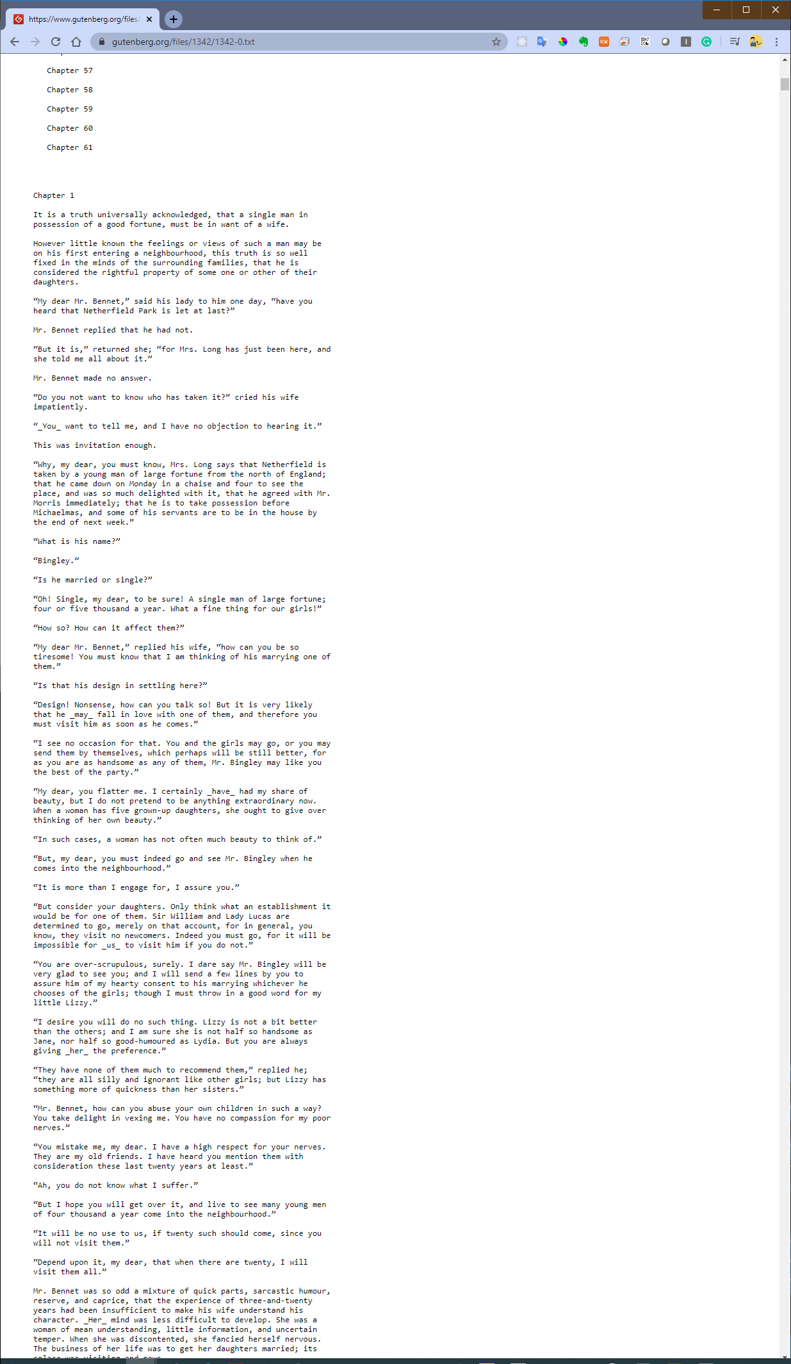
Download data
https://www.gutenberg.org/ebooks/1342

Slide 4
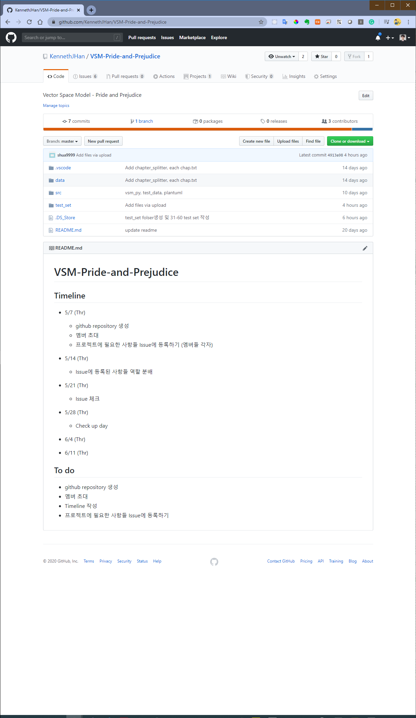
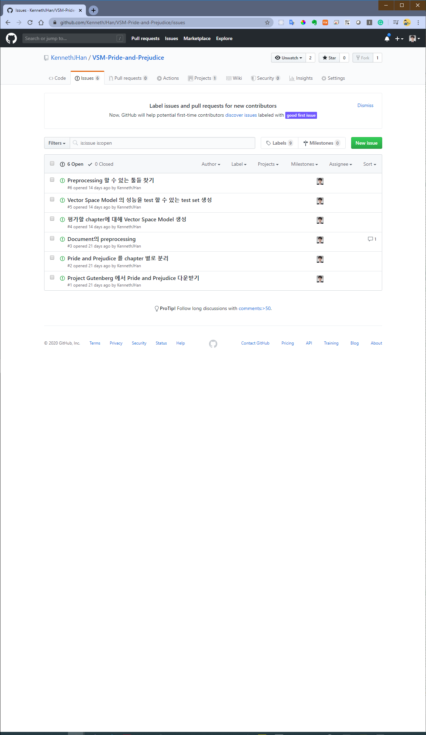
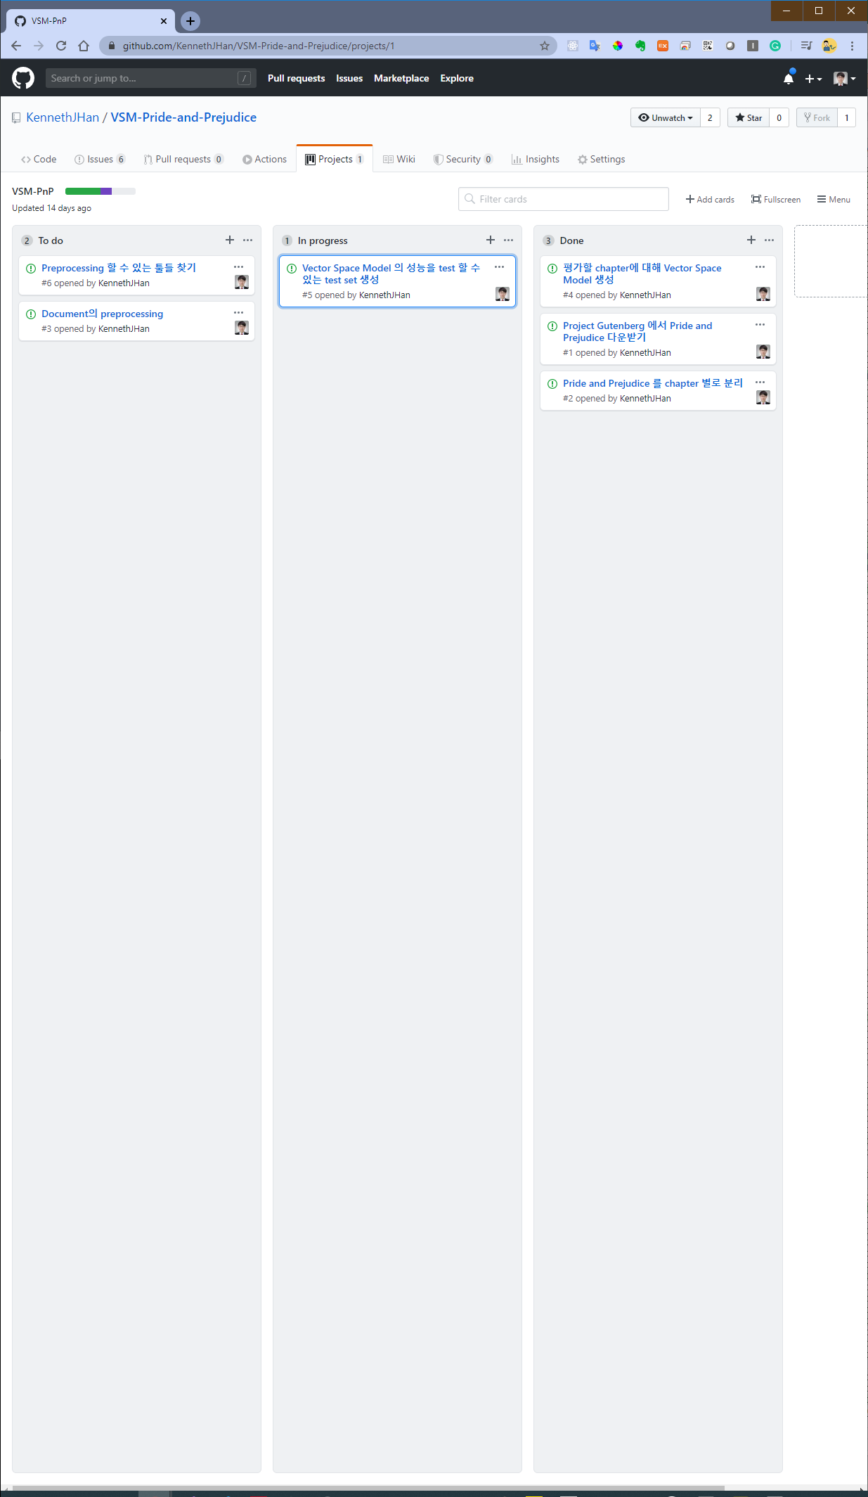
Github

Slide 5
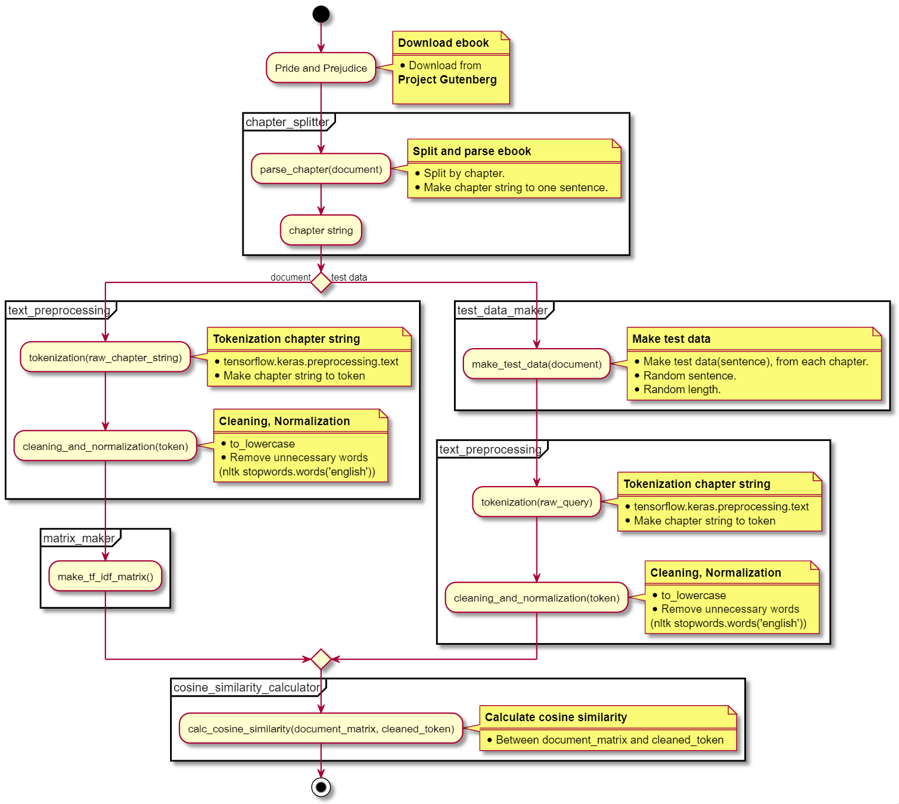
Flowchart

Slide 6
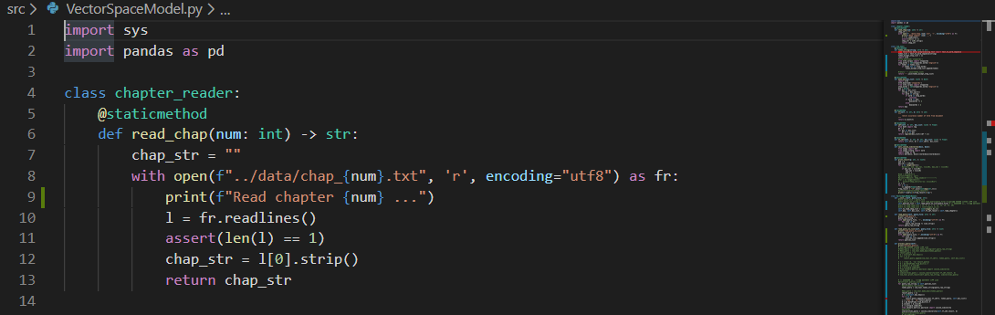
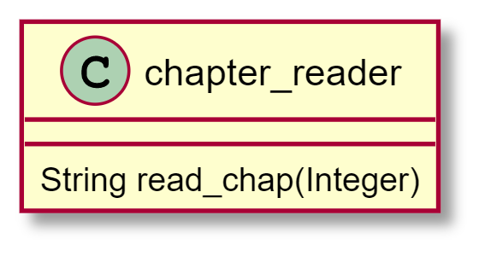
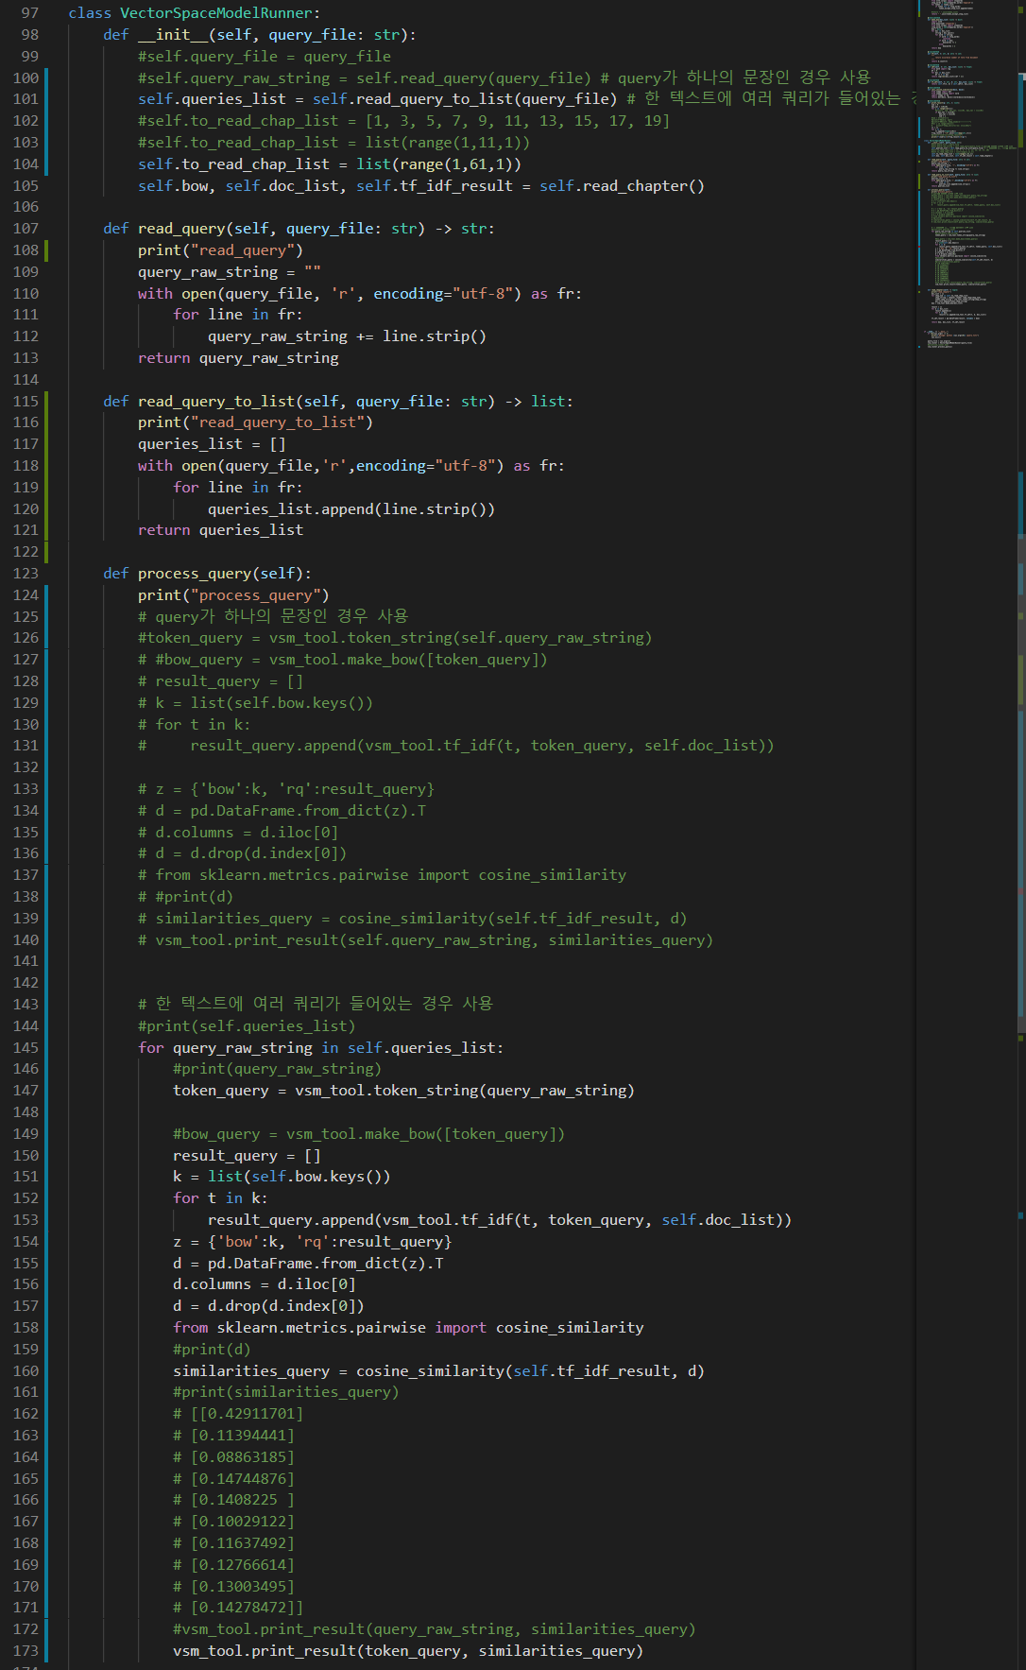
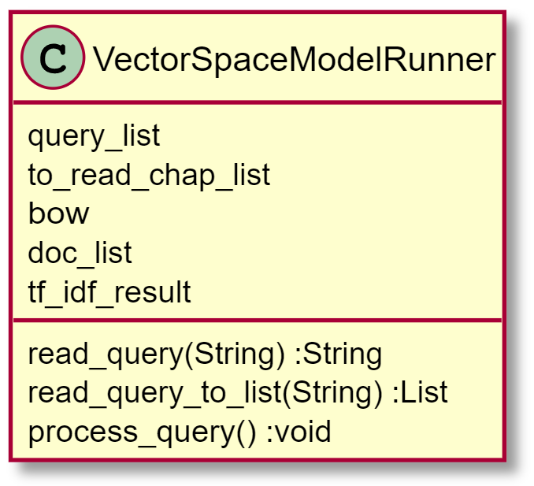
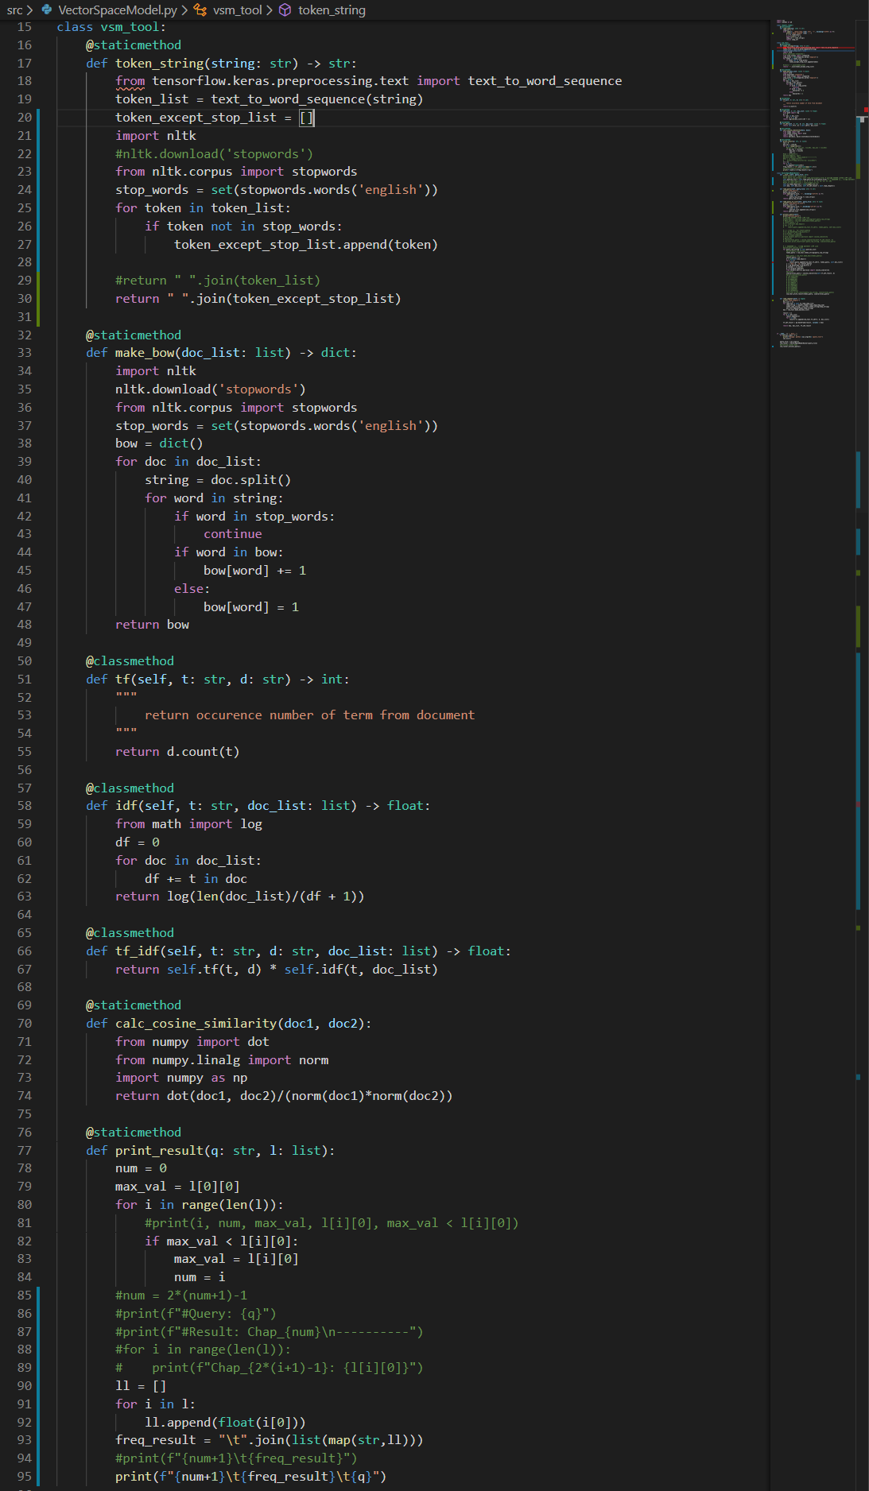
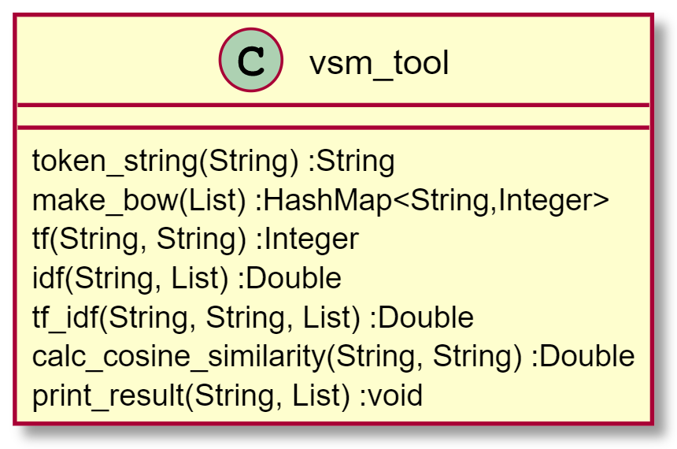
Source code

Slide 7
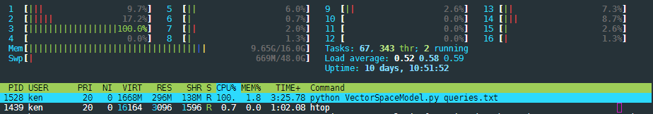
Run
All 60 Chapter, 111 queries..
286.45 seconds..
(4min 46 sec..)

Slide 8
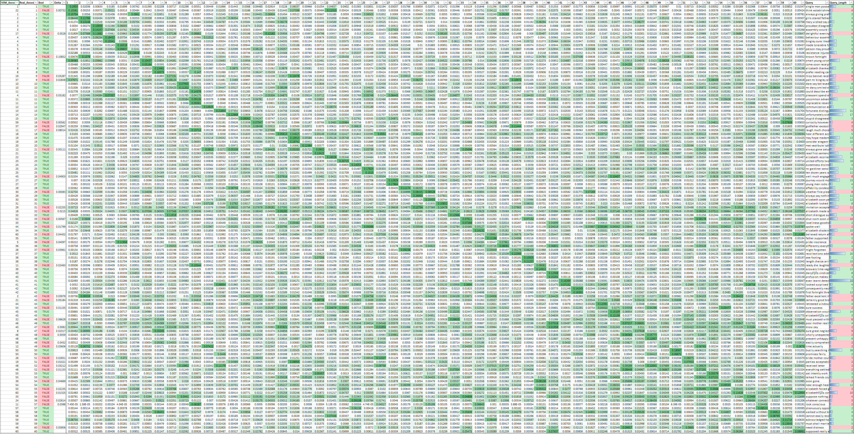

Result

Slide 9

Result
...
TRUE: 71
FALSE: 40
→ 63.96%

Slide 10
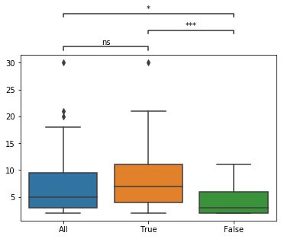
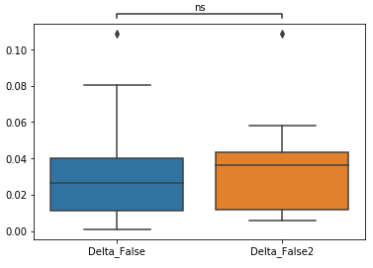
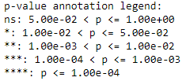
Discussion
맞추지 못한 40개의 데이터들의 특징은 무엇인가?
Query의 길이가 짧은 것인가?
Query | Raw query | Predict | Result | delta
know say | I know not what to say. | 40 | 47 | 0.0082
time actually | By this time she is actually with them! | 12 | 49 | 0.0360
known fortnight | She has known him only a fortnight | 2 | 6 | 0.1085
All vs. True: 2.534e-01
True vs. False: 2.358e-04
All vs. False: 1.248e-02

Slide 11
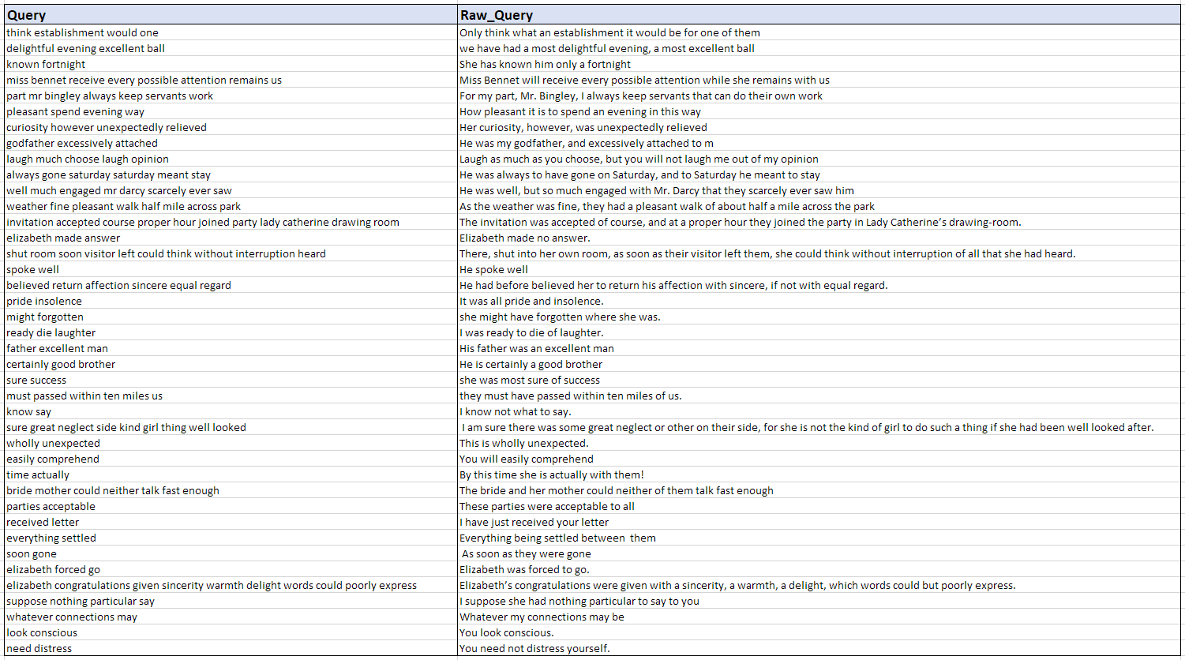
False queries

Slide 12
To be continued..

